Slide 1

Name: Bhumik Rathod
Rollno: 22MCA009
Company: TechElecon Pvt. Ltd.
External Guide: Satyam Raval
Faculty Guide: Dr. Lata Gohil

Slide 2
Gear Pattern Image App (GearCare)

Slide 3
Contents
About Company
Objectives
Scope
Tools & Technologies Used
Diagrams
System Design
Screenshots
Testing
Future Enhancement
References

Slide 4

About Company
Tech Elecon Pvt. Ltd is the IT division of the Elecon group of companies and has more than 25 years of experience in the fields of hardware, software, and networking solutions. Situated in the heart of Vitthal Udyognagar Industrial Estate and in the proximity of the educational town of Vallabh Vidyanagar. Tech Elecon is all set to reach new heights in the field of IT solutions.
Tech Elecon has extensive experience in providing IT services and has successfully adapted to technological advancements, making it the leading IT infrastructure management service provider in the region. Our cutting-edge delivery model covers all stages of the solution lifecycle, including planning, deploying, managing, maintaining, auditing, upgrading, and improving.

Slide 5
Objectives
Create a user-friendly application to optimize gear and gear box management workflows,
facilitating secure login,
register new components(Gear’s),
monitoring condition through real-time data visualization, and
efficient service and maintenance execution, with the goal of improving operational effectiveness and prolonging equipment lifespan.

Slide 6
Scope
Login: Users can securely login to the application.
Home: After login, users are directed to the home screen.
Images: Users can view images associated with different components.
Registration (Gear): Users can register new gears or gear boxes by entering a unique serial number, which will be validated and approved by the server.
Dashboard: Real-time data of approved gear boxes, including vibration and temperature graphs, is displayed using web socket technology.

Slide 7
Condition Based Monitoring (CBM): Users are notified of service requirements based on gear condition, with visual indicators highlighting service needs or completed service life.
Service & Maintenance Notifier: Users are reminded of upcoming service and maintenance requirements based on gear life cycle.
Service & Maintenance Execution: Field officers can manage service and maintenance tasks, executing operations and filling out survey forms through the application. Images of the gear or gear box can be uploaded at the end of each survey for documentations.

Slide 8



Tools Used
Android Studio: Application Development Suit for Android and SDK manager for flutter.
VS Code: Lightweight code editor by Microsoft for various programming tasks.
Figma Desktop (Student Version): Cloud-based design tool tailored for students for UI/UX design and collaboration.

Slide 9



Technologies Used
Flutter: Utilized for cross-platform mobile app development, ensuring a consistent user experience across different devices and operating systems.
Web-Socket: Employed for real-time data fetching from IoT sensors, enabling instant communication between the sensors and the app.
Firebase: Used as a backend service to store data, manage user authentication, and facilitate real-time updates across devices.

Slide 10
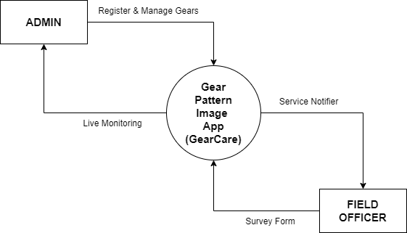
Diagrams
Context Diagram
Fig. 1

Slide 11
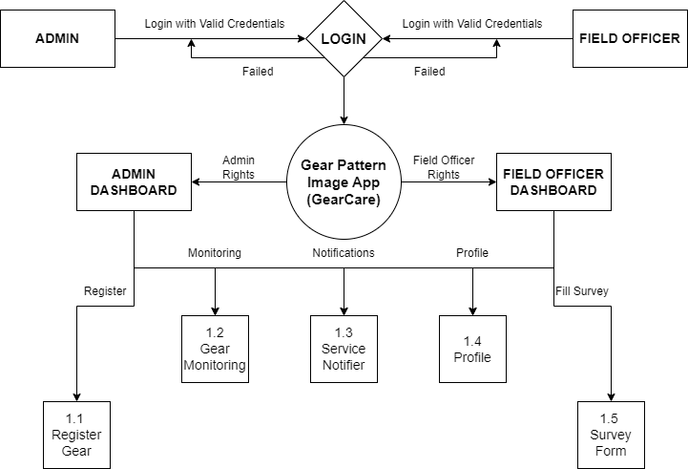
First Level DFD
Fig. 2

Slide 12
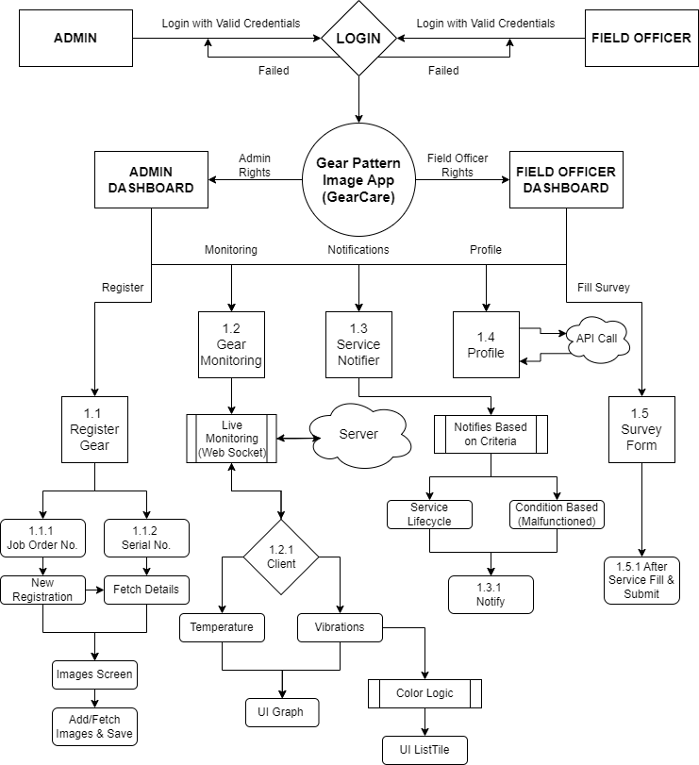
Second Level DFD
Fig. 3

Slide 13
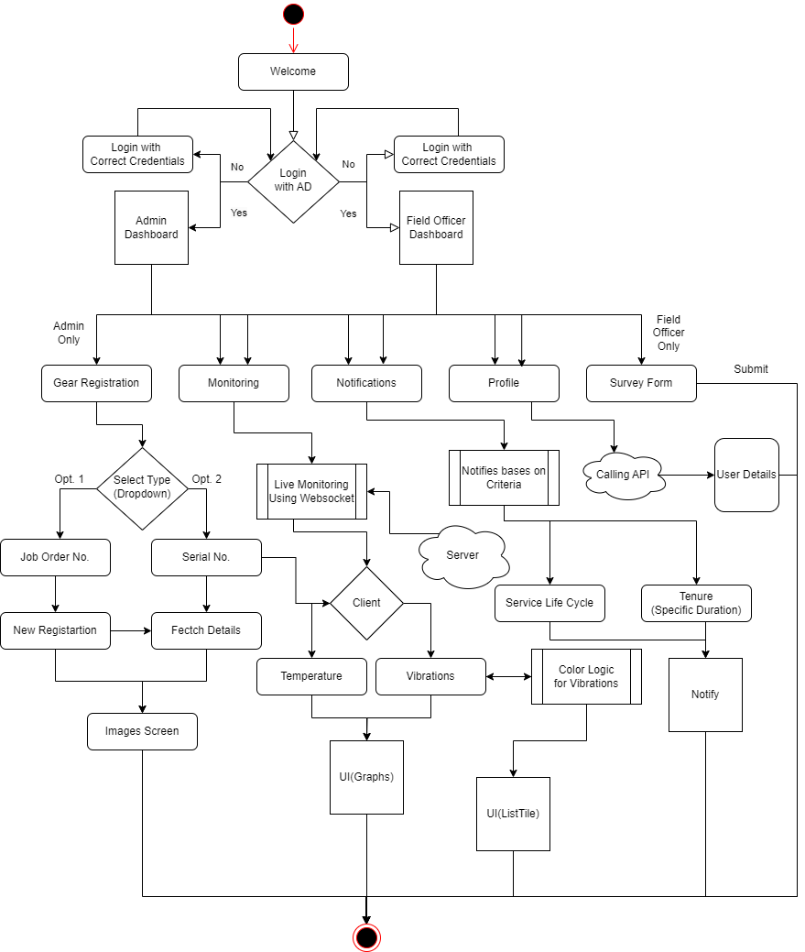
System Design
System Flow
Fig. 4

Slide 14
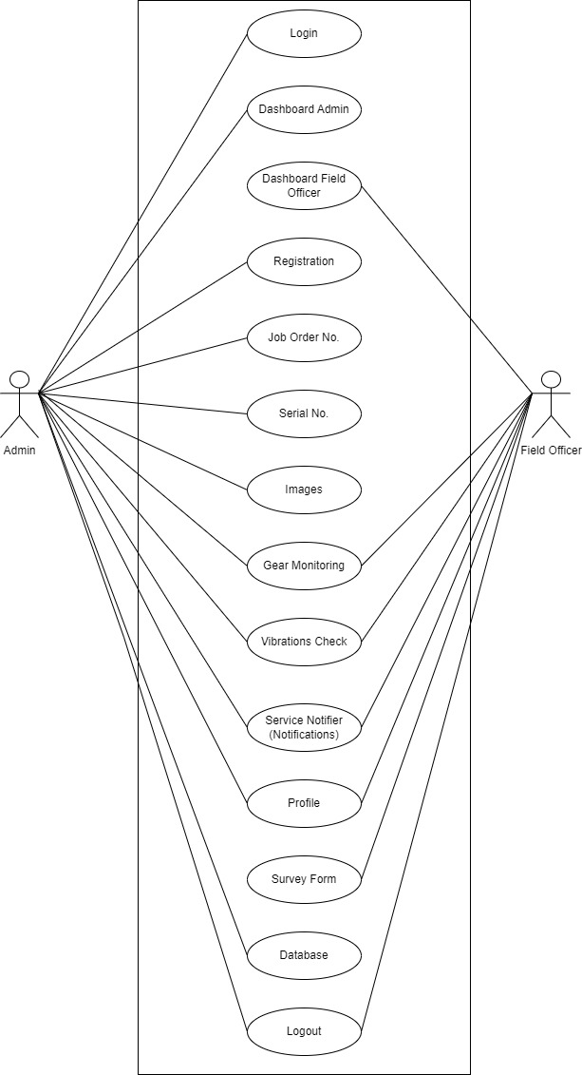
Use-Case Diagram
Fig. 5

Slide 15
Data Dictionary
In this Project there are mainly three collections/tables are used which are as follows:
Collection Name: 1. user_logins 2. jobOrders
3. survey_forms

Slide 16
Collection Name: user_logins
Description: User Login Tracking with Timestamp
Sr. No. | Field Name | Data Type | Description | Example
1 | Document Id | String | Auto Generated Doc. Id’s | 2QKODadvTwzi5BD1b4zh
2 | email | String | Email Id of User | user@techelecon.com
3 | login_timestamp | String | Date and Time Log | 2024-04-20 – 10:35
Table - 1 user_logins

Slide 17
Collection Name: jobOrders
Description: Gear Registration Recording and Fetching already added.
Sr. No. | Field Name | Data Type | Description | Example
1 | Document Id | String | Auto Generated Doc. Id’s | FZAoJk0DUk2UNWIm0K
2 | assemblyDetails | String | Details of Assembly Parts | Gear Shafts or Bearings
3 | class | String | Class of Gear (A, B, C, D) | Class B
4 | descriptionDetails | String | Gear/ Part Description | Spur Gear or Helical Gear
5 | jobOrderNo | String | Unique Id no. for Tracking | 531256
6 | serialNo | String | No. of the part registered | SN654
Table - 2 jobOrders

Slide 18
Collection Name: survey_forms
Description: Survey form for Record Purpose (Filled After Servicing Gear/Parts)
Sr. No. | Field Name | Data Type | Description | Example
1 | Document Id | String | Auto Generated Doc. Id’s | HZAoJk0DUk2UcWIm0y
2 | answers | Map | Options / Checkboxes selected in survey form are treated as answers here | {temperature: "no", vibrations: "yes", rotations: "na", sound: "yes", condition: "yes"}
3 | notes | String | Class of Gear (A, B, C, D) | "Rotation/Minute isn’t Ok."
4 | serialNo | String | No. of the part registered | SN446
5 | login_timestamp | String | Unique Id no. for Tracking | 531256
6 | serialNo | String | Date and Time Log | 2024-04-20 – 10:35
Table - 3 jobOrders

Slide 19
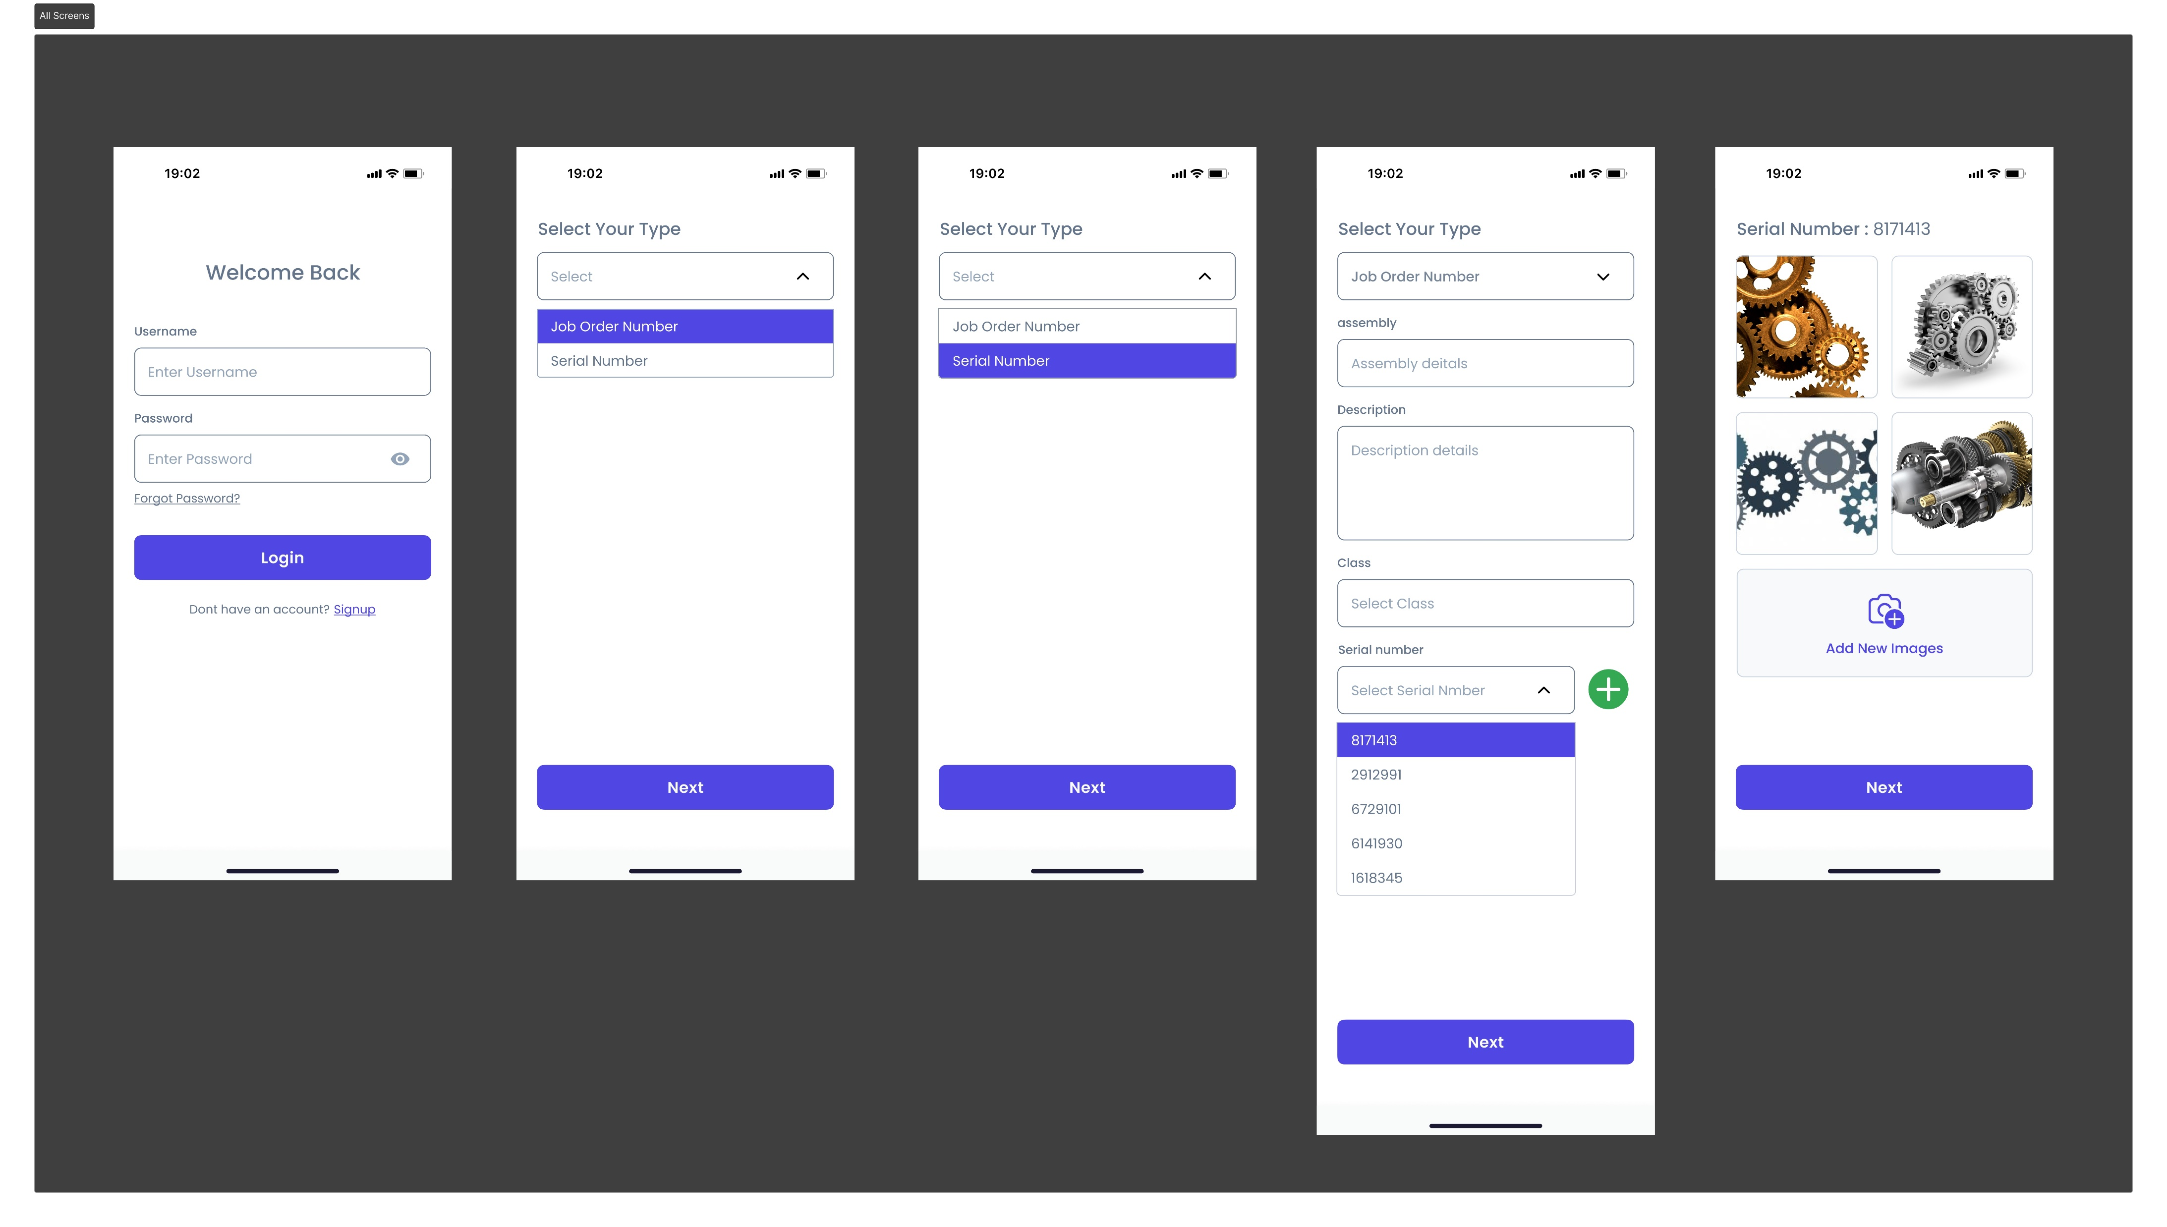
Figma Design Prototype - 1

Slide 20
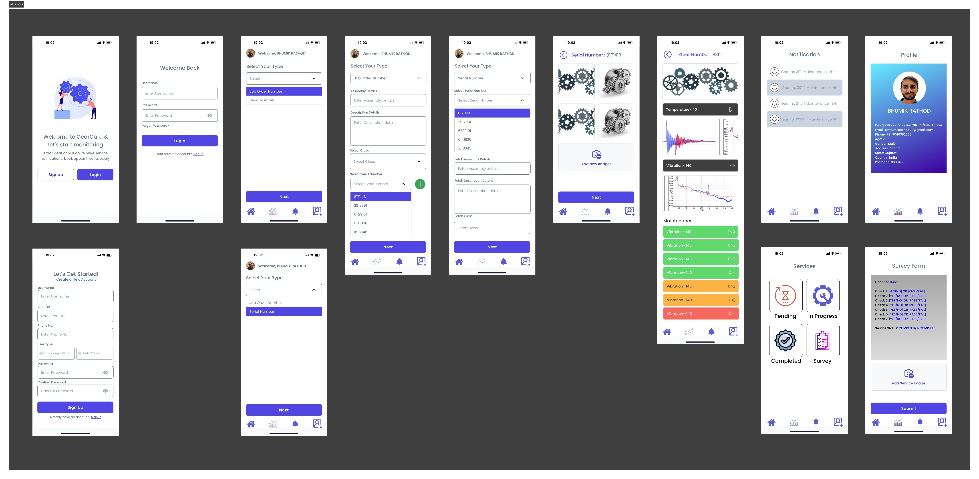
Figma Design Prototype - 2

Slide 21

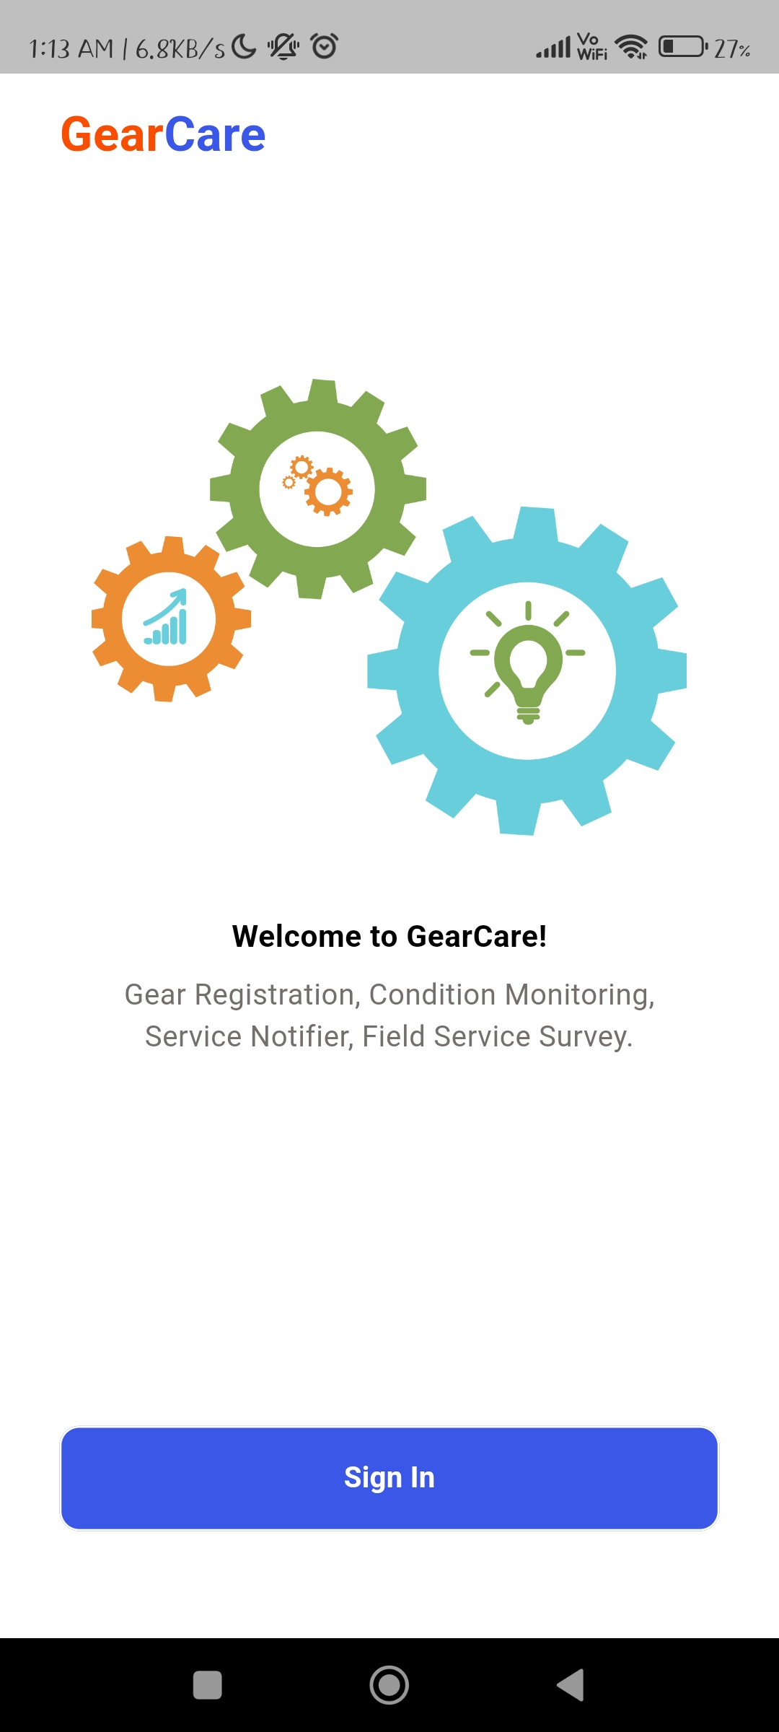
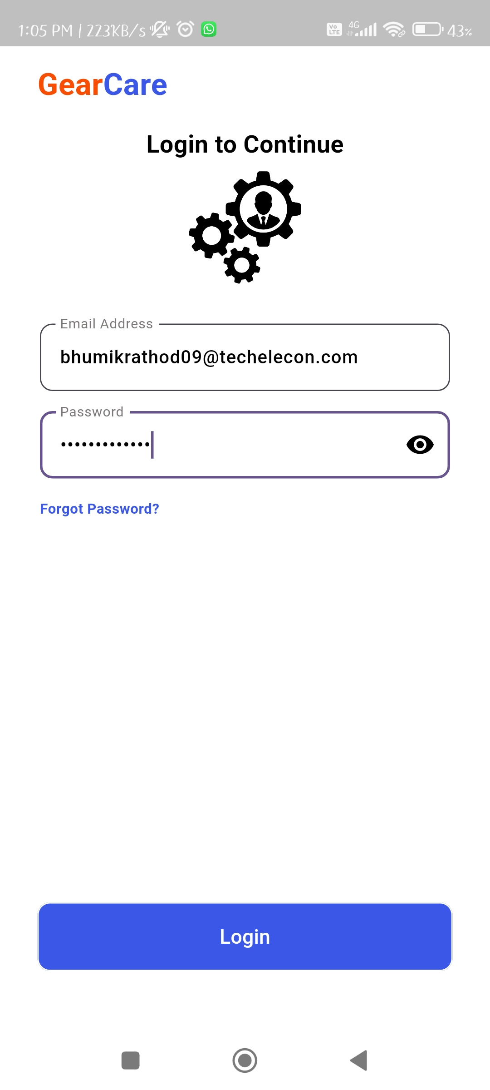
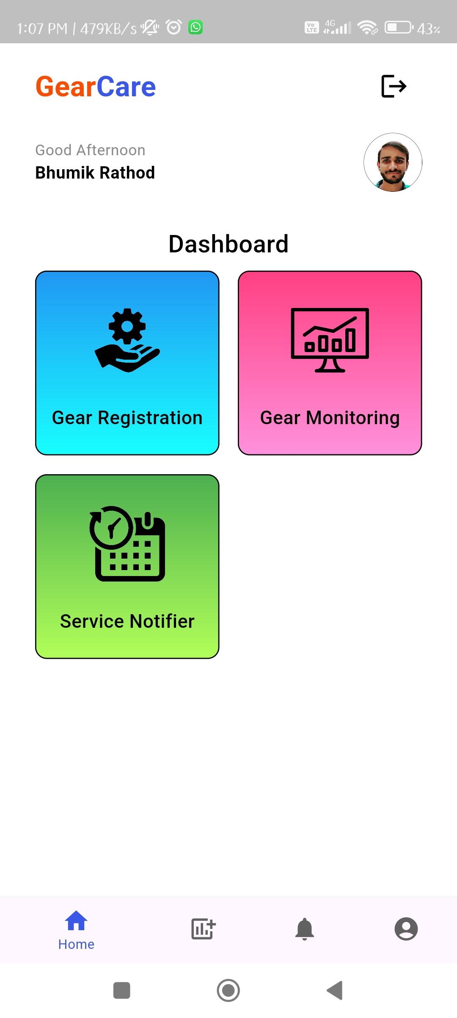
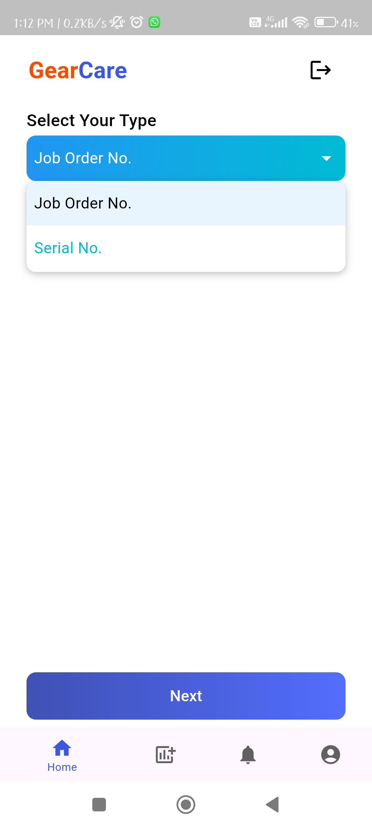
Screenshots
Img1 – Splash Screen
Img2 – Welcome Screen
Img3.1 – Login Screen
Img4 – Admin Dashboard
Img5.1 – Dropdown
Img 5.1 – Splash Screen Img 5.2 – Welcome Screen
Img 5.3.1 – Login Screen Img 5.4 – Admin Dashboard

Slide 22
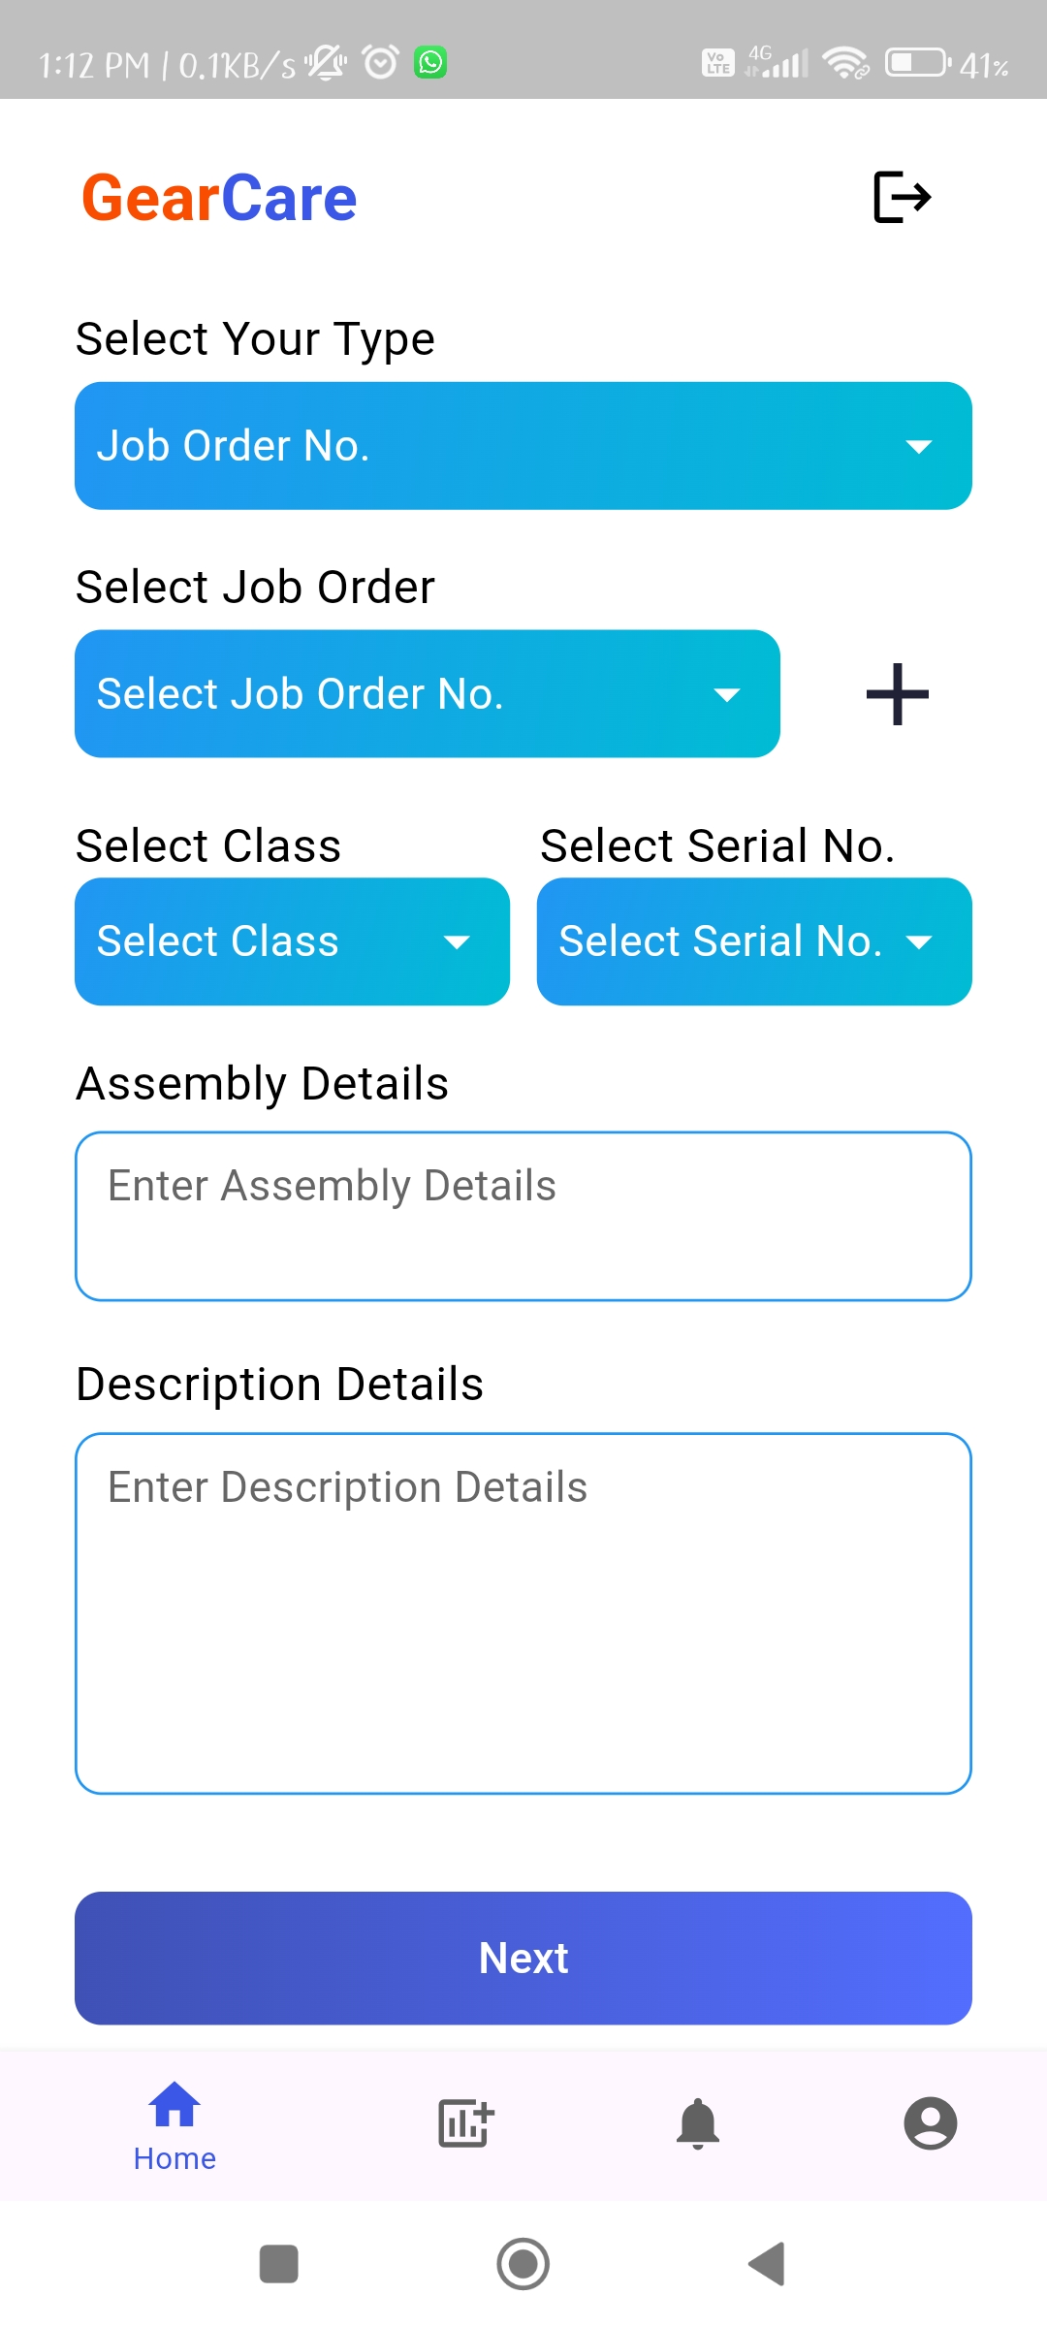
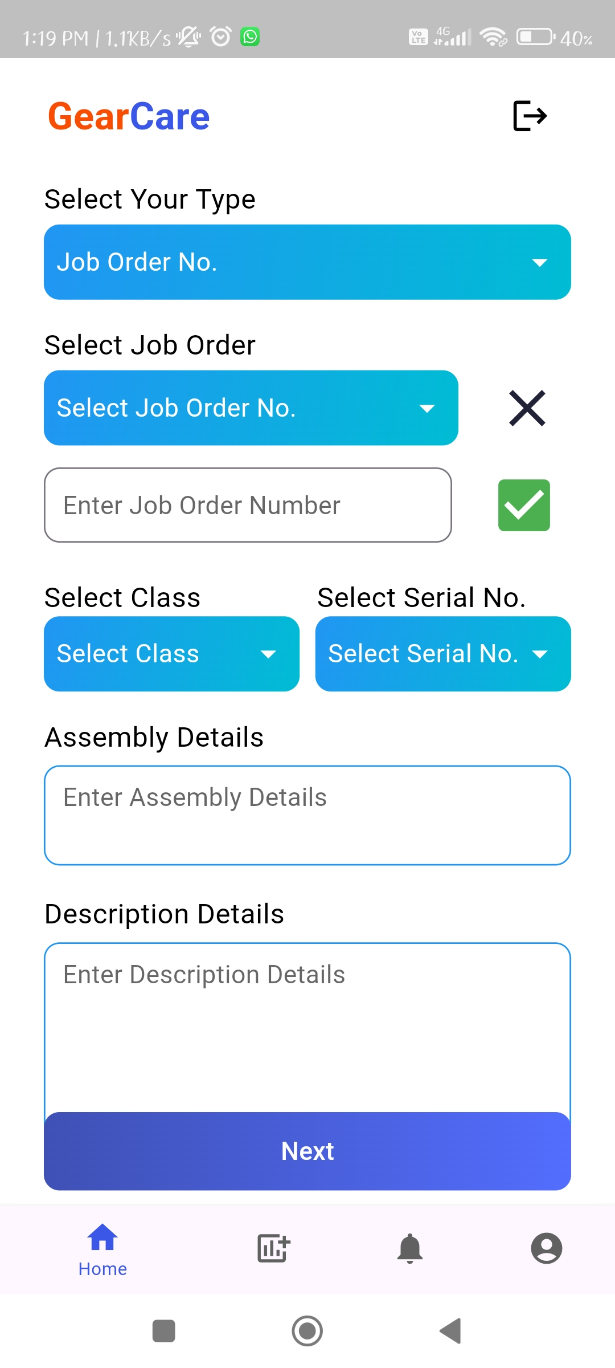
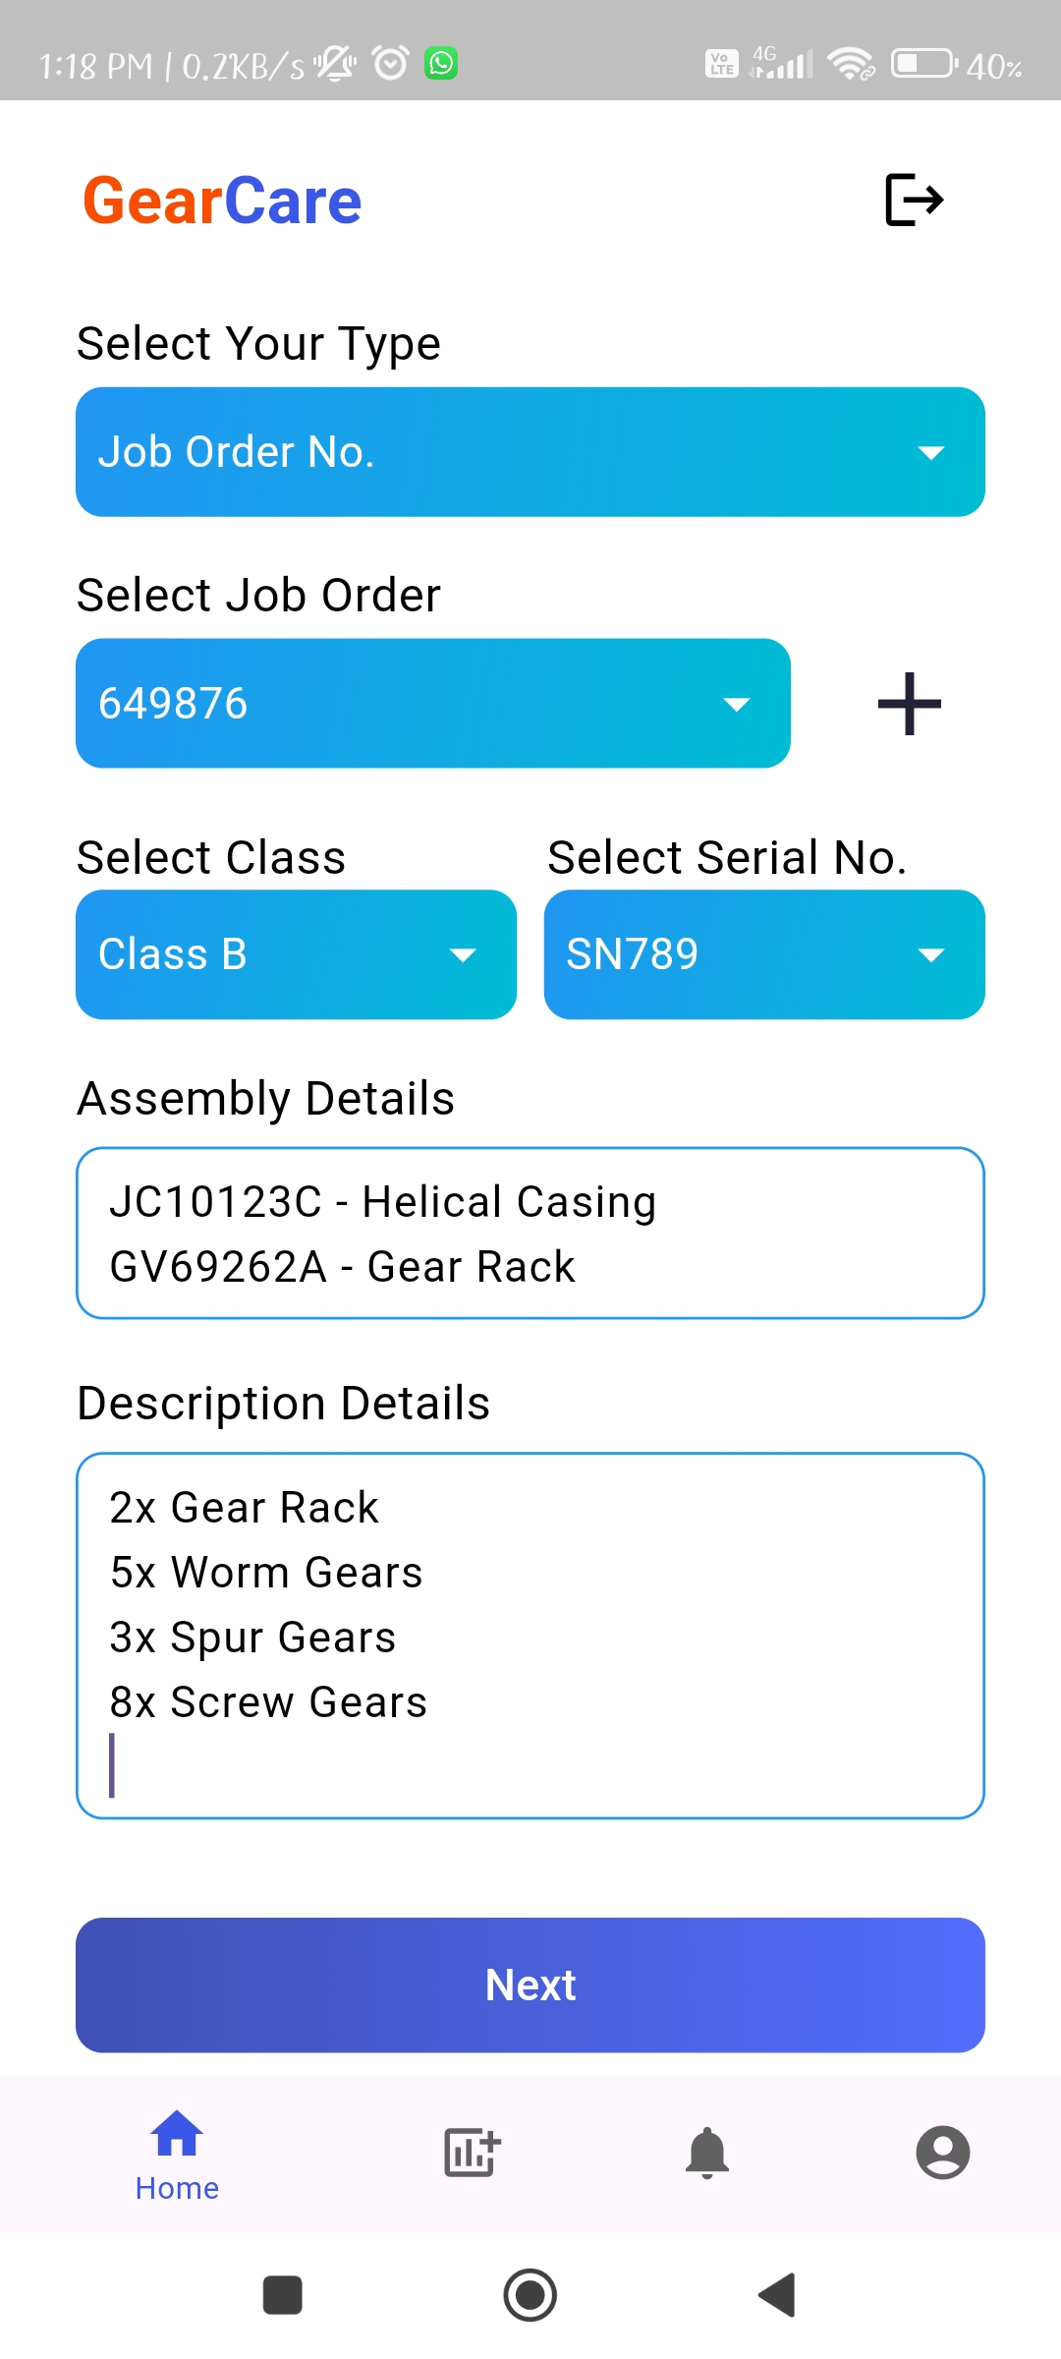
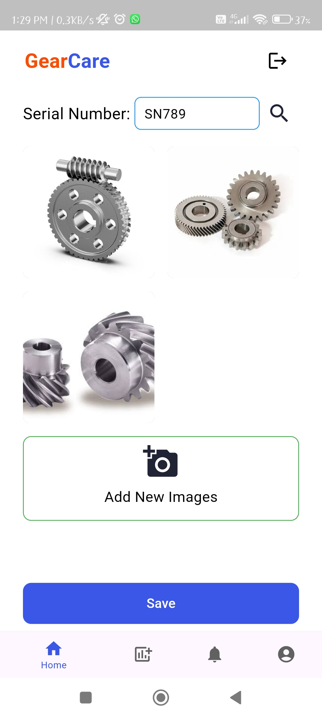
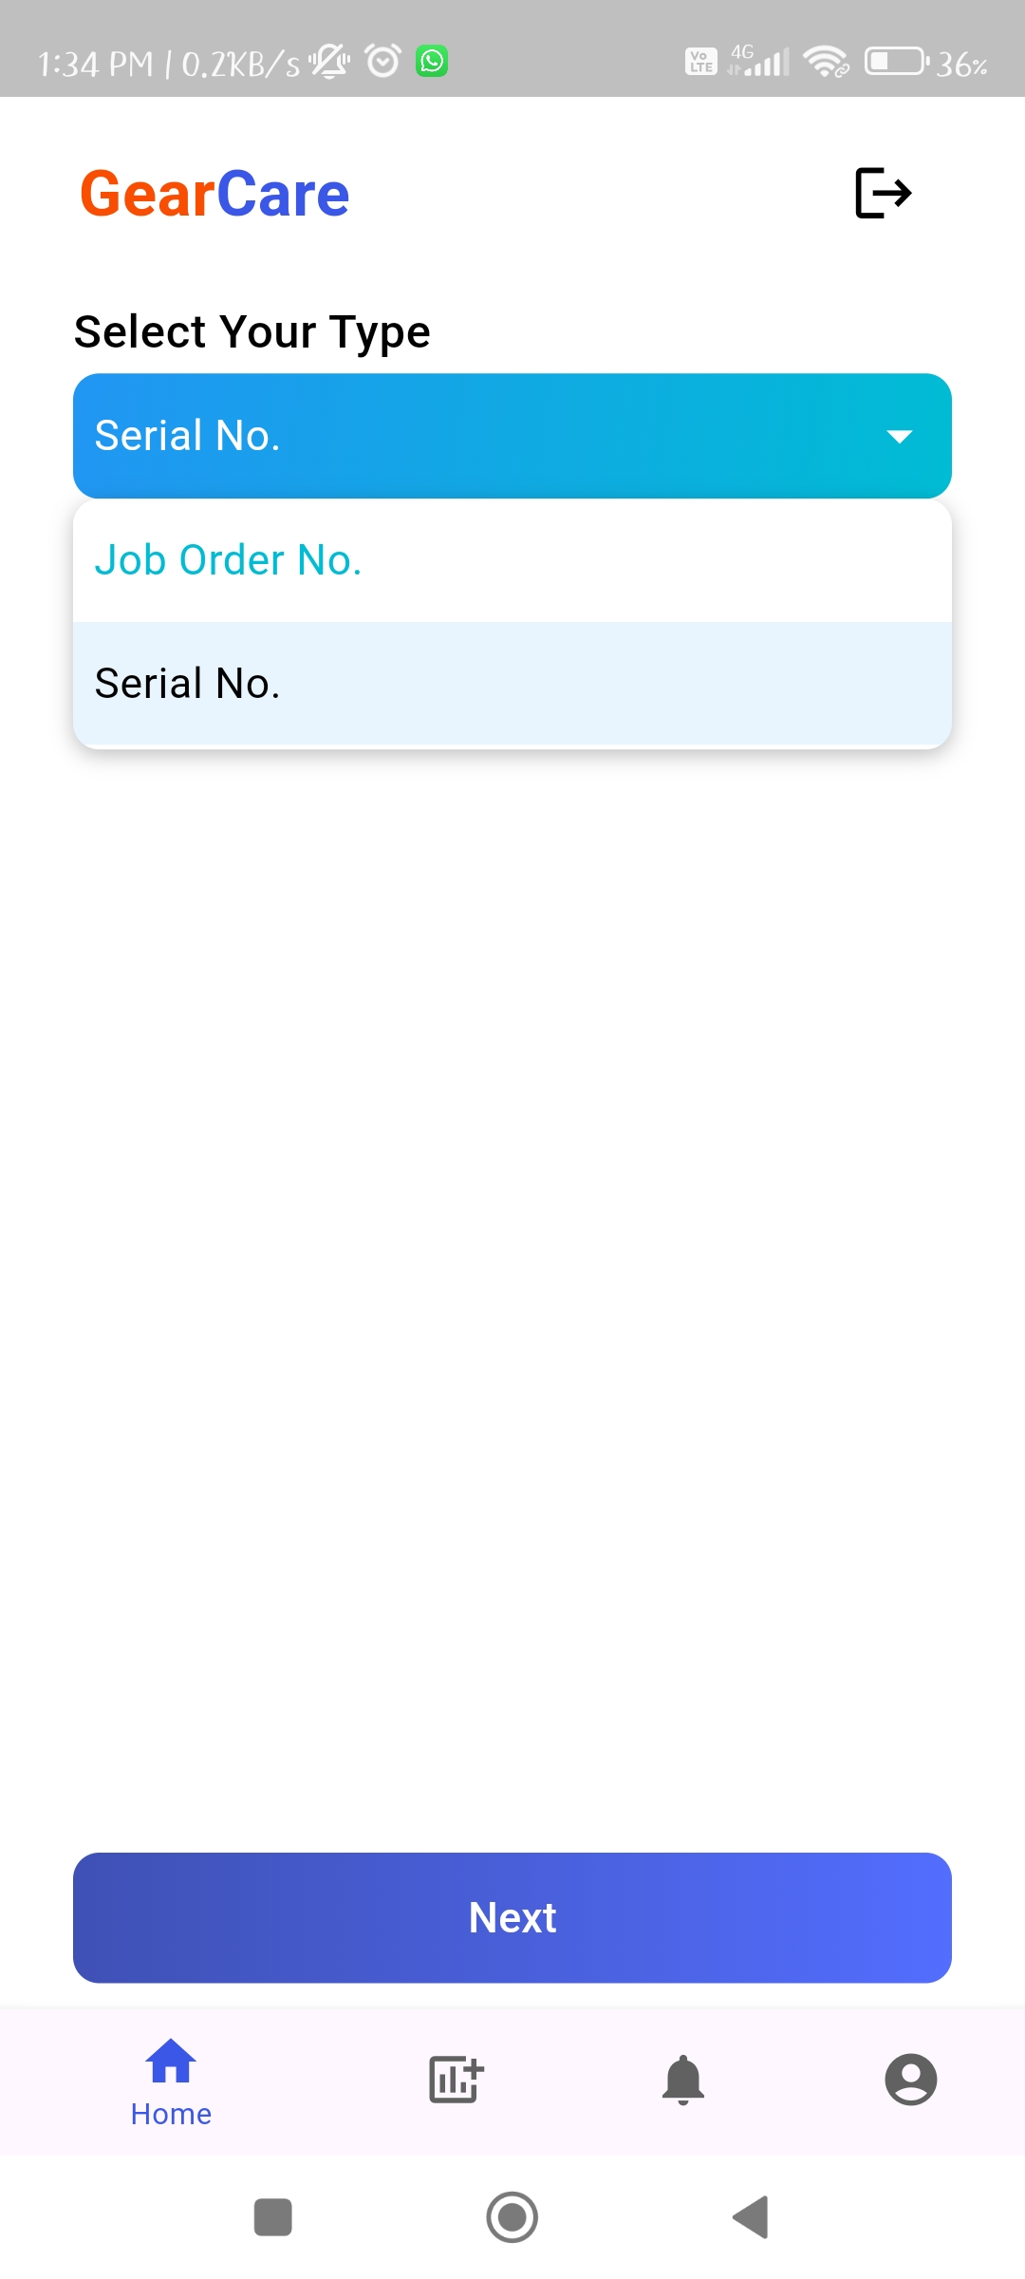
Img6.1 – JobOrder No.
Img6.1.1 – JobOrder No.
Img6.1.2 – JobOrder No.
Img7.1 – Images Screen
Img5.2 – Dropdown

Slide 23
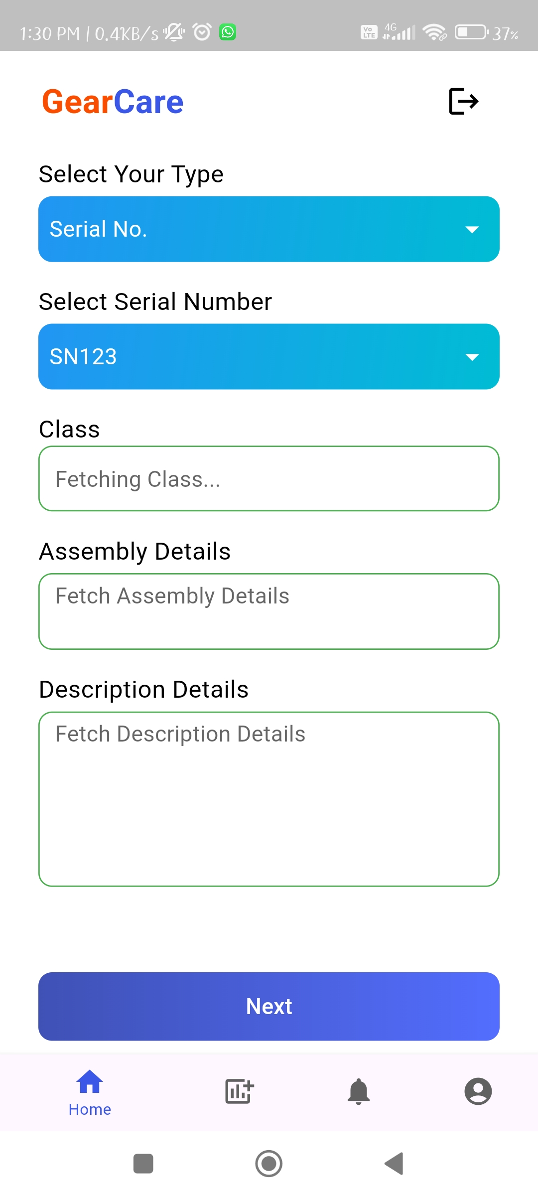
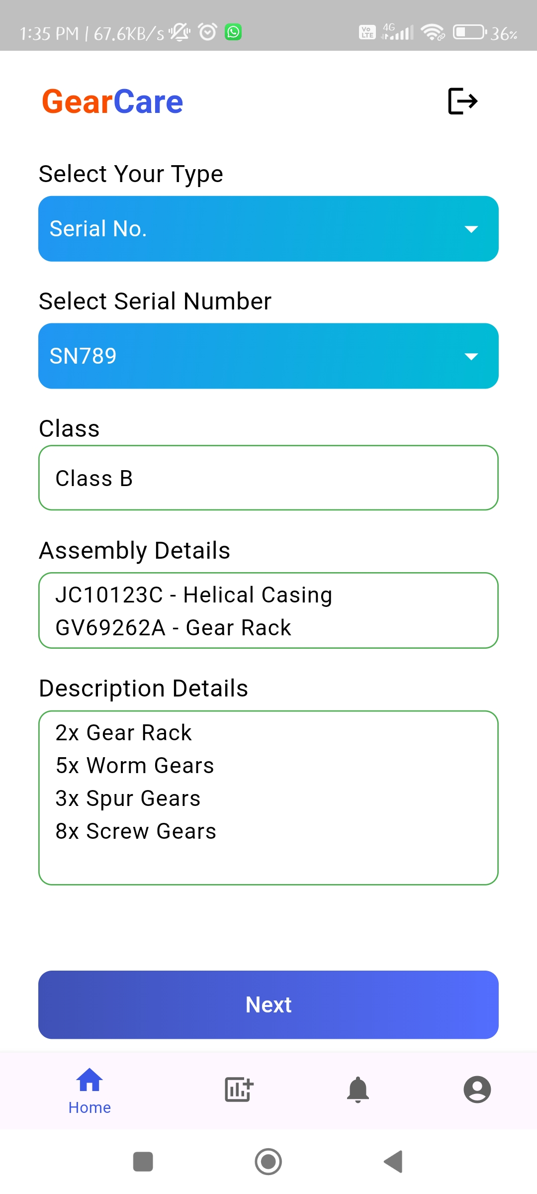
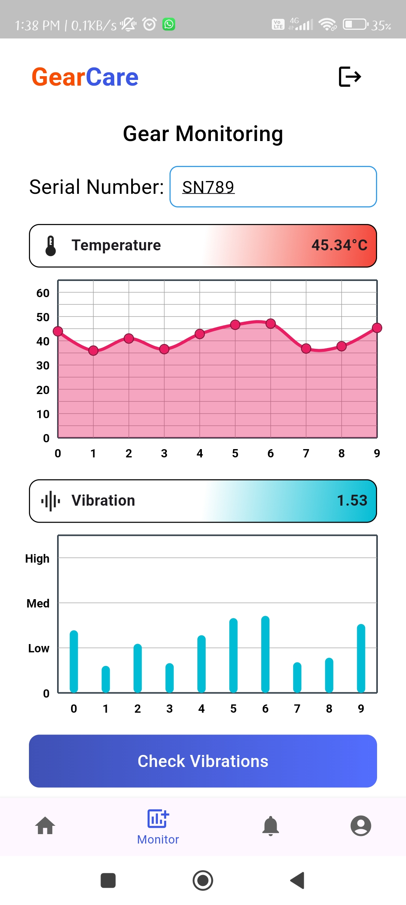
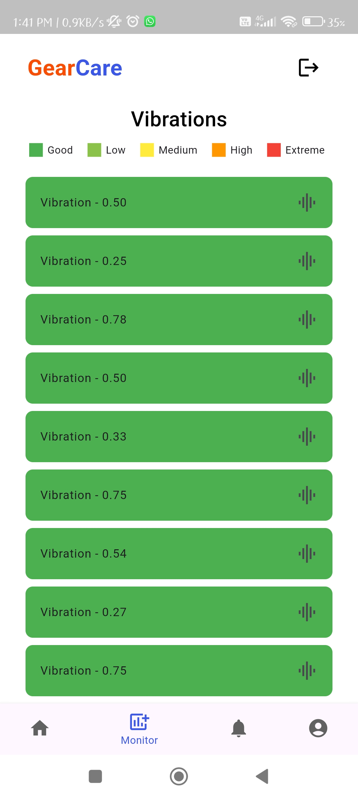
Img8.1 – Serial No.
Img8.2 – Serial No.
Img7.2 – Images Screen
Img9 – Live Monitoring
Img10.1 – Vibrations Scr.

Slide 24
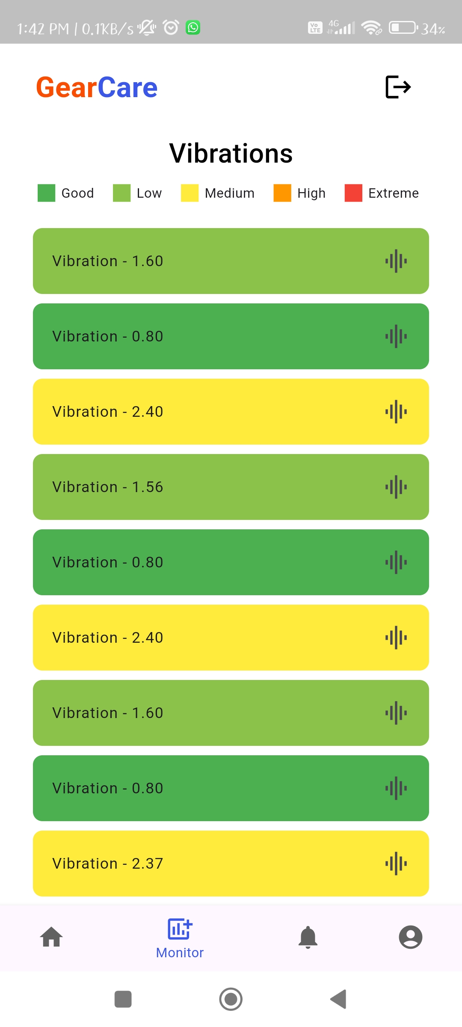
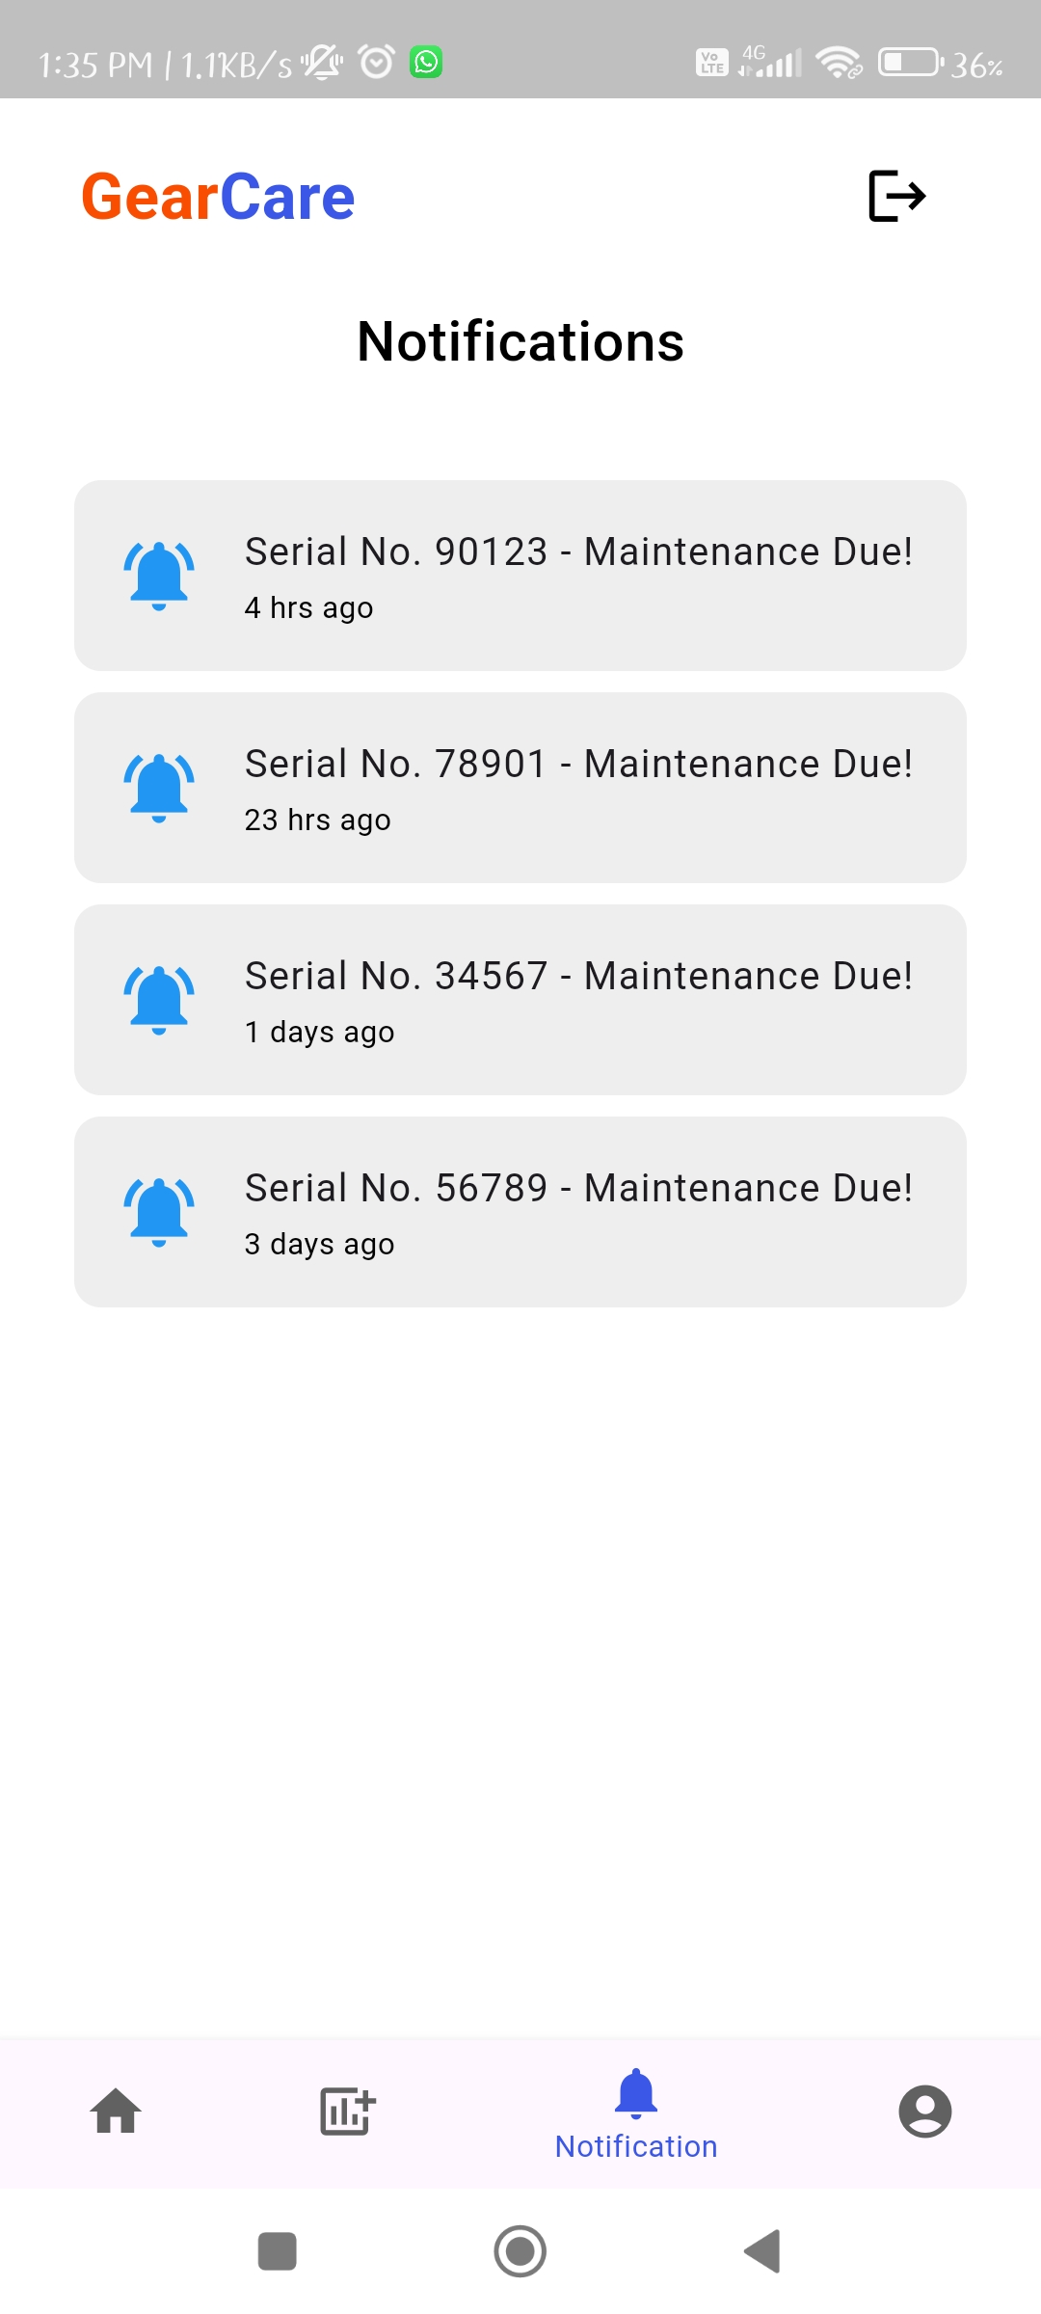
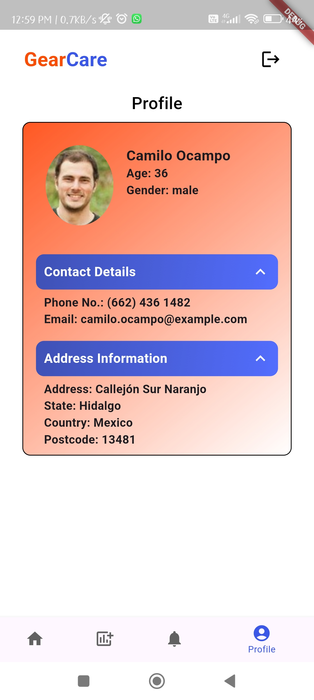
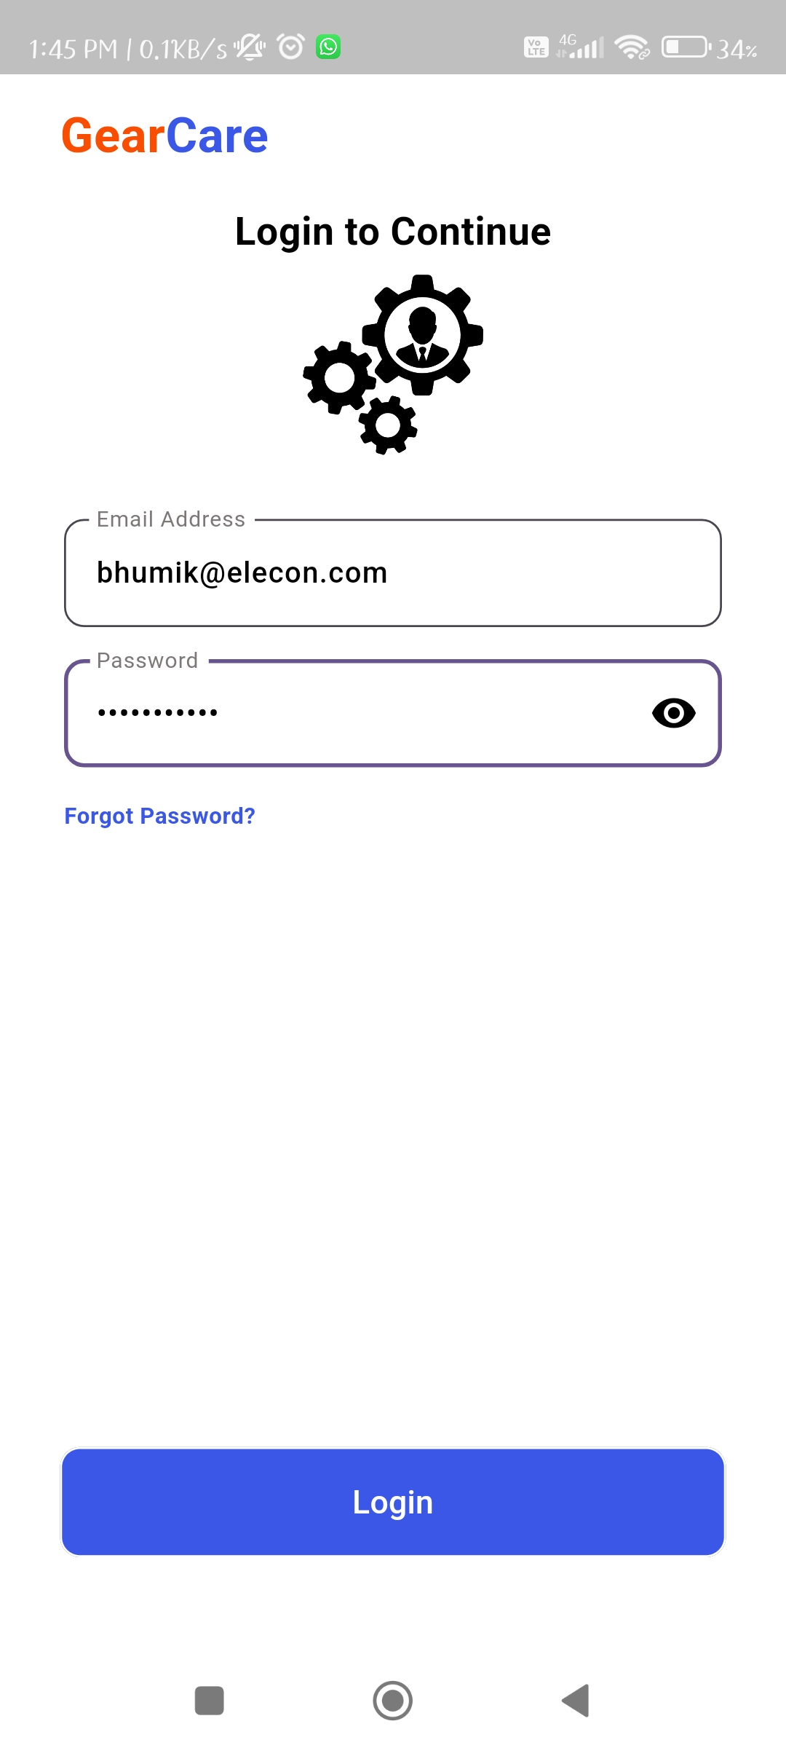
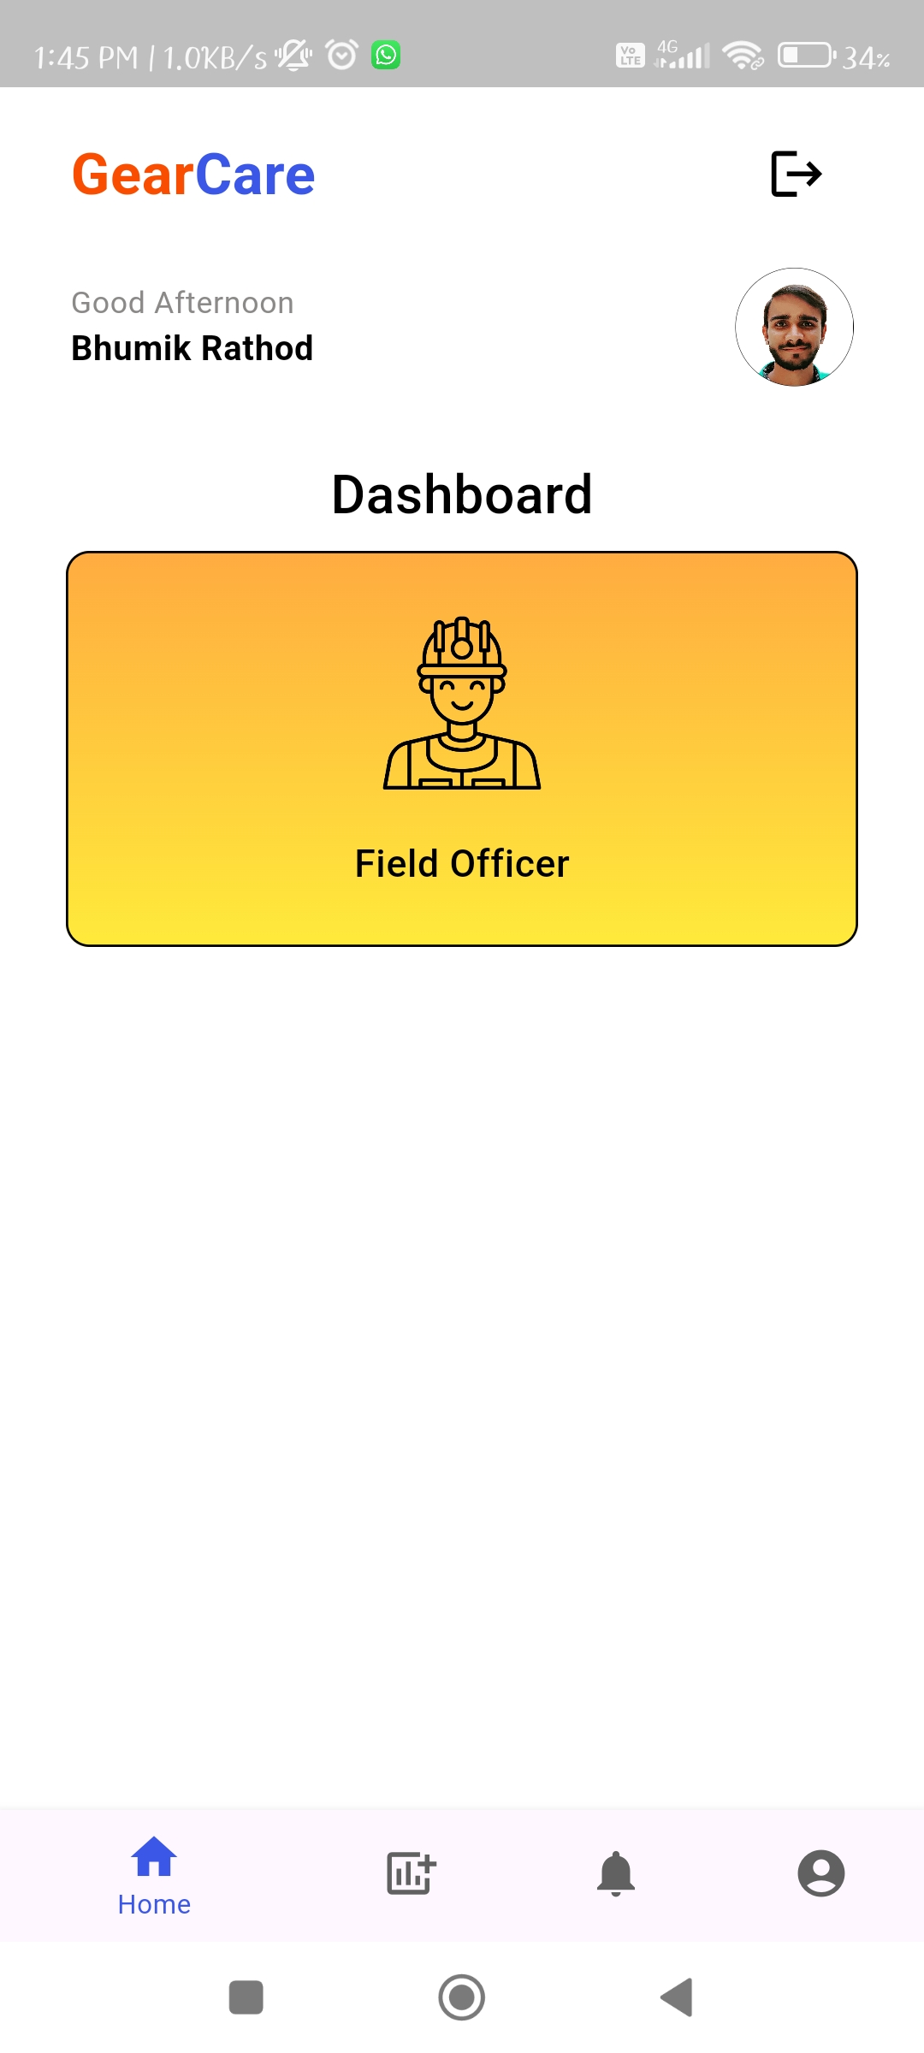
Img10.2 – Vibrations Scr.
Img10.2 – Notifications
Img11 – Profile Screen
Img3.2 – Login Screen
Img12 – Field Officer Dashboard

Slide 25
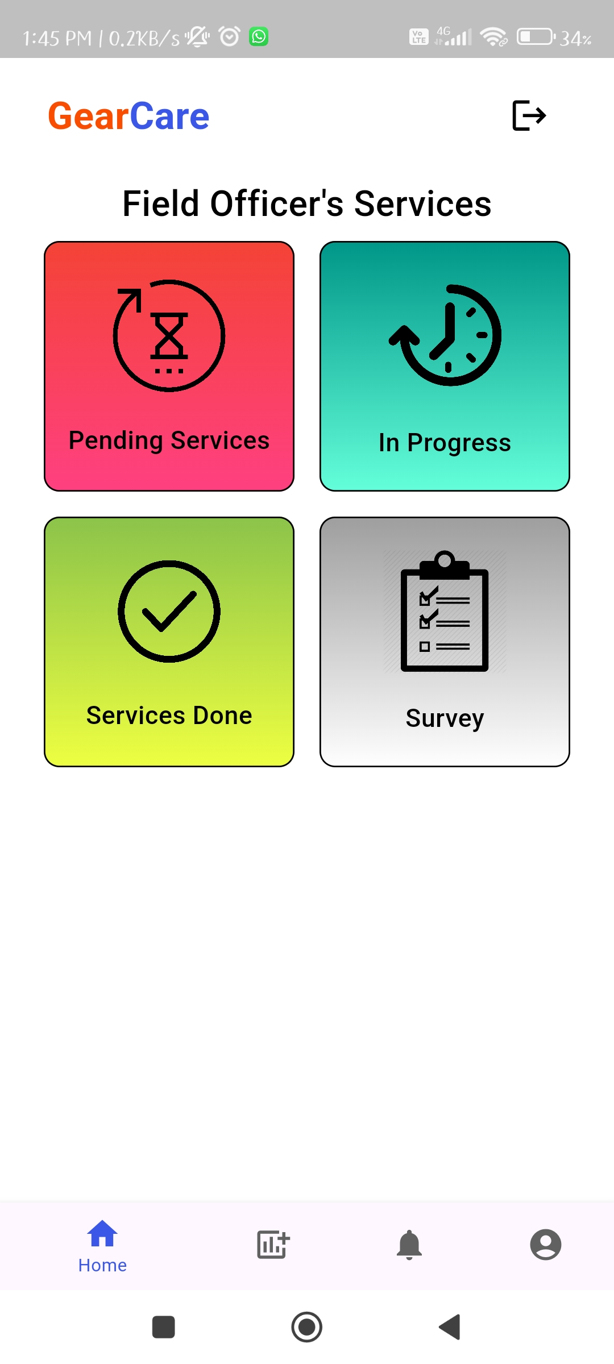
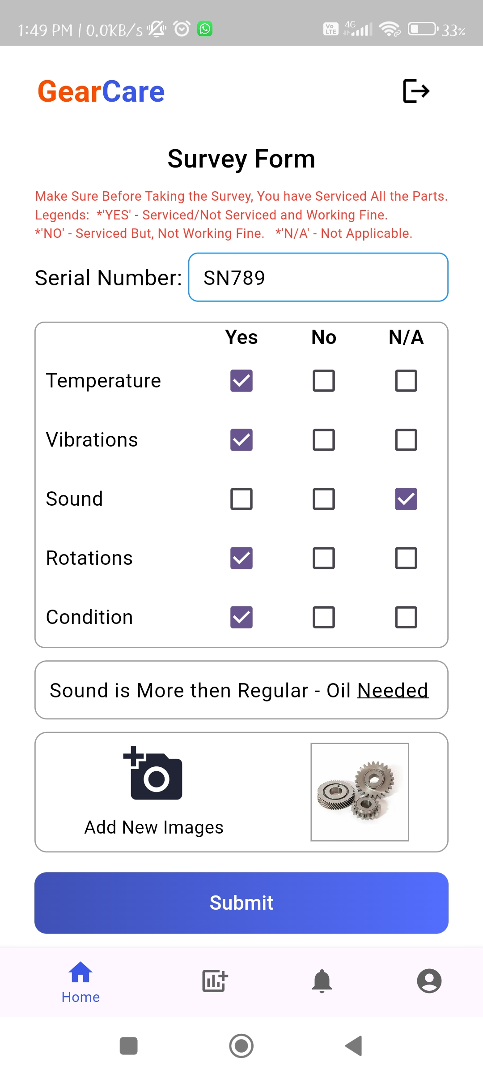
Img13 – Field Officer Services
Img14 – Survey Form

Slide 26
Testing
Sr. No. | Screen | Description | Condition |  | Input | Output | Result
 |  |  | Pre | Post
01 | Login | Verify user can securely log in to the application | User credentials are correctly entered | User is directed to the home screen upon successful login | Valid username and password | User is logged in and directed to the home screen | Pass
02 | Login | Test for handling invalid login attempts | User enters incorrect credentials | Error message is displayed | Invalid username and password | Error message indicating invalid credentials | Pass
03 | Home | Ensure users are directed to the home screen after login | User is logged in | Home screen is displayed | User logged in | Home screen displayed | Pass
04 | Images | Check if users can view images associated with different components | User is on the images screen | Images are displayed | Navigate to the images screen | Images of components displayed | Pass
05 | Gear Registration | Test the registration process for new gears or gearboxes | User is on the registration screen | Gear is successfully registered | Unique serial number for a new gear | Confirmation message for successful registration | Pass
06 | Gear Registration | Verify system handles duplicate serial numbers during registration | Serial number already exists in the database | Error message is displayed | Serial number already in use | Error message indicating duplicate serial number | Pass
07 | Monitoring | Test real-time data visualization on the monitoring screen | User is on the monitoring screen | Real-time data is displayed | Navigate to the dashboard | Vibration and temperature graphs displayed | Pass

Slide 27
Sr. No. | Screen | Description | Condition |  | Input | Output | Result
 |  |  | Pre | Post
08 | Notifications | Check if users receive alerts based on gear condition | Gear requires service | User/Field officer is notified | Gear condition triggers service requirement | Visual indicator highlighting service need | Pass
09 | Notifications | Verify users receive reminders for upcoming service and maintenance requirements | Scheduled service or maintenance is approaching | User/Field Officer is reminded | Time for scheduled service or maintenance | Notification for upcoming service/maintenance | Pass
10 | Logout | Test if users can securely log out of the application | User is logged in | User is logged out and directed to the login screen | Click on logout button | User is logged out | Pass
11 | Gear Registration | Check system response to invalid inputs during registration | Invalid data entered during registration | Error message is displayed | Invalid serial number format | Error message indicating invalid input | Pass
12 | Monitoring | Ensure dashboard data refreshes properly | Data on dashboard is outdated | Data is refreshed | Trigger data refresh | Updated real-time data displayed | Pass
13 | Monitoring | Test if user can navigate from the home screen to the monitoring screen | User is on the home screen | User is on the monitoring screen | Tap on monitoring button on the home screen | Monitoring screen displayed | Pass

Slide 28
Sr. No. | Screen | Description | Condition |  | Input | Output | Result
 |  |  | Pre | Post
14 | Login | Test for failed login with space in email id | Getting error message | User is not able to log in | Account credentials with spaces before and after | Error message indicating account is blocked | Fail
15 | Gear Registration | Verify failed registration due to network issue | Network is unavailable during registration | Registration fails | Valid serial number for registration | Error message indicating registration failed due to network issue | Fail
16 | Monitoring | Check if dashboard fails to load outdated data | Outdated data is present on the dashboard | Error message is displayed | Attempt to load outdated data | Error message indicating data load failure | Fail

Slide 29
Future Enhancement
While the app has met its initial objectives, there are opportunities for further enhancements. Future updates could include additional features such as predictive maintenance analytics, enhanced integration with other enterprise systems, and expanded IoT capabilities.
Continuous feedback from users will be crucial in identifying and prioritizing these enhancements to ensure the app evolves to meet changing needs and technological advancements.
Additionally, the field officer module should be given priority in future enhancements. This module requires further development, particularly for the pages related to pending services, in-progress services, and completed services. Enhancing these aspects will improve the efficiency and effectiveness of field operations, leading to better service delivery and user satisfaction.

Slide 30
References
flutter_local_notifications: "Flutter Local Notifications", Version 17.0.1
fl_chart: "FL Chart: A Flutter Charting Library", Version 0.35.0
image_picker: "Image Picker: A Flutter Plugin for Picking Images", Version 1.1.1
flutter_dropdown: "Flutter Dropdown", Version 1.0.0
cupertino_icons: "Cupertino Icons", Version 1.0.8
firebase_core: "Firebase Core for Flutter", Version 2.31.0
cloud_firestore: "Cloud Firestore for Flutter", Version 4.17.3
firebase_storage: "Firebase Storage for Flutter", Version 11.7.5
firebase_database: "Firebase Database for Flutter", Version 10.5.5
http: "HTTP: A Composable, Future-Based Library for Making Requests", Version 1.2.1
intl: "Intl: Internationalization and Localization Support", Version 0.19.0
rxdart: "RxDart: Reactive Extensions for Dart", Version 0.27.7
timezone: "Timezone: A Flutter Package for Timezone Management", Version 0.9.2

Slide 31
Thank You!

